Slide 1
Project Presentation of CO-OP Project at Industry (Module-2) (22CS421)
Food Waste Prediction Using Machine Learning Models Vanshak Bhardwaj
2210990942
Supervised By
Gurpreet Singh
Department of Computer Science and Engineering,
Chitkara University, Punjab
1

Slide 2
Introduction
Global food waste exceeds one billion tons annually, with two-thirds of post-consumption waste generated by private households. In India, household waste reaches 78 million tons yearly, averaging about 50kg per individual. Rotting food in landfills accounts for 8% to 10% of human-driven global greenhouse gas emissions. UN SDG 12.3 sets a critical target to halve consumer and retail food waste by 2030. Traditional waste management relies on rough estimates, leading to overproduction and inefficiencies. Machine learning offers a proactive solution by identifying complex consumption patterns over time. This project implements Random Forest and LSTM models to shift operations from reactive guessing to intelligent demand forecasting.
2

Slide 3
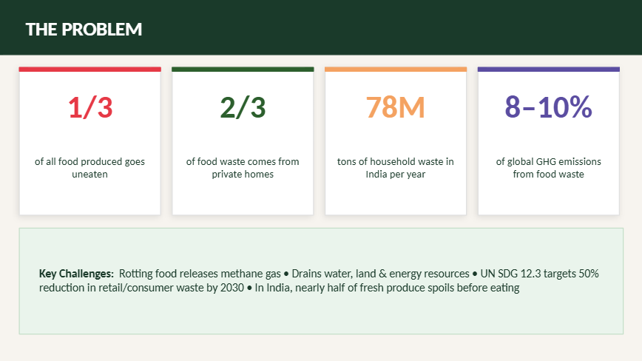
The Problem

Slide 4
Datasets and Features
Primary Sources: * Open data (Kaggle Messy Food Waste Dataset).
National/Global reports (FAO, UNEP, JRC).
IoT Sensor data (Load cells for weight, ultrasonic sensors for bin fullness).
Key Feature Categories:
Temporal: Weekdays vs. weekends, seasonal transitions, and holidays.
Environmental: Weather conditions and storage settings.
Operational: Current inventory levels, serving portions, and batch sizes.
Contextual: Venue type and customer demographics.
4

Slide 5
Methodology – Algorithm Selection
Random Forest: Stands out for ranking input features and handling noisy logistics data stably.
LSTM (Long Short-Term Memory): Used to track long-term temporal dependencies and trends in waste generation over time.
CNN (Convolutional Neural Networks): Implemented for visual recognition to detect food spoilage through images.
Hybrid Systems: Combining IoT sensor readings (temperature, moisture, gas) with machine learning for early decay detection.
5

Slide 6
Performance and Results
Predictive Accuracy: Random Forest and LSTM models have yielded precision scores over 90%.
Waste Reduction: Implementations show a decrease in waste ranging from 14% to 52%.
Smart Bins: AI-integrated containers hit approximately 93% accuracy in sorting or predicting overflow.
Manufacturing/Retail: Systems forecasting garbage volume in these sectors reach up to 92% precision.
•
6

Slide 7
Challenges and Limitations
Data Scarcity: Collecting precise household waste records in specific regions of India is currently difficult.
Model Opacity: Highly accurate deep-learning models often act as "black boxes," making it hard to understand specific predictions.
Economic Barriers: Modern IoT sensors can be expensive and unaffordable for small restaurants or rural areas.
Cultural Factors: One-size-fits-all models struggle with regional eating habits and cultural differences in India.
7

Slide 8
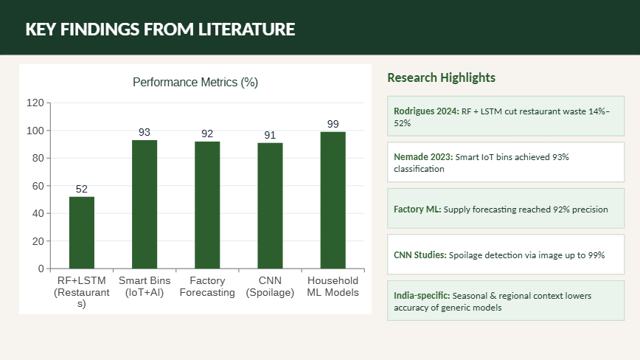
Key findings from literature

Slide 9
Sustainability and Future Directions
SDG 12.3: Aligning with the UN target to halve retail and consumer food waste by 2030.
Explainable AI (XAI): Focusing on making AI models more trustworthy and practical for human users.
Federated Learning: Training models locally (in-home/in-kitchen) to protect data privacy.
Policy Integration: Using ML insights to scale programs like India's "Save Food Share Food."
9

Slide 10
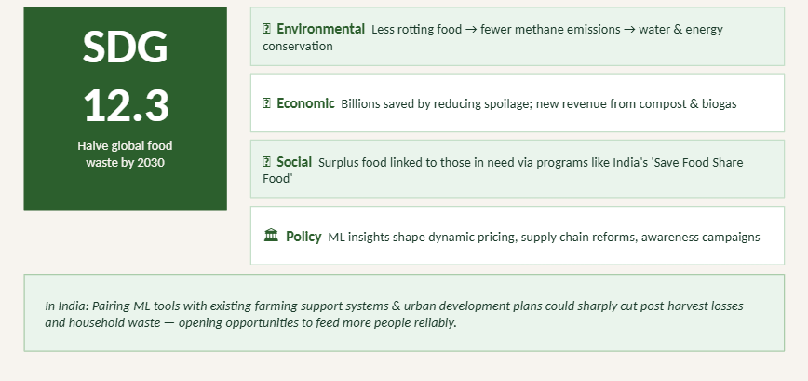
Implications for sustainability & Policy

Slide 11
Conclusion
Machine learning effectively predicts demand and identifies spoilage patterns before waste occurs.
These models can reduce overproduction by up to 10% or more when properly integrated with real-world data.
Success depends on high-quality data and a synthesis of knowledge from diverse sources to improve system efficiency and environmental health.

Slide 12
Thank You
12

